Slide 1
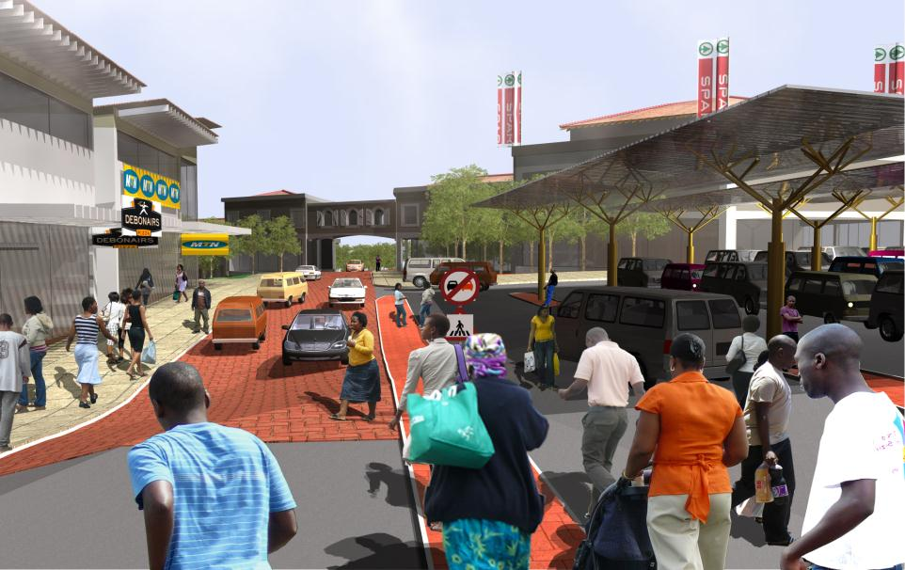
National Treasury
Neighbourhood Development PROGRAMME
A Sustainable Settlement Collective: Creating the Built Environment Professionals Needed to Realise the
2030 NDP Vision
Notes:
1

Slide 2
SECTIONS
Section 1: | Background & Context
Section 2: | The Challenge: The Human Dimension
Section 3: | Development of a Built Environment Professional
Section 4: | The Role of Institutions & Power Collective Action
Section 5: | The Sustainable Settlements Collective: Objectives into Actions
Section 6: | Taking Collective Forward Process

Slide 3
CONTEXT OF THE NEIGHBOURHOOD DEVELOPMENT PROGRAMME
The NDP was established in 2006 and is responsible for managing the Neighbourhood Development Partnership Grant. Grant Purpose:
From the start of the programme until the end of 2012/13 the NDP has:
Approved municipal business plans to a value of R4.0bn
Approved project plans to the value of R 3.9 bn.
Completed 129 municipal NDP projects
Disbursed a total of R615m to service providers and municipalities, 94% of its budget.
To support and facilitate the planning and development of neighbourhood development programmes and projects that provide catalytic infrastructure to leverage 3rd party public and private sector development towards improving the quality of life of residents in targeted underserved neighbourhoods (townships generally) Division of Revenue Bill, 2013 (Bill No. 02 of 2013)

Slide 4
NEIGHBOURHOOD DEVELOPMENT PROGRAMME TOWNSHIP DEVELOPMENT LESSONS: 2006-2011
Cities as spaces:
Multiple spatially disparate “ad-hoc” projects have low impact
Township development in the absence of an integrated & co-ordinated city-wide urban regeneration strategy has low impact
Land issues dictate project progress and viability
Mixed-use transit orientated development is a good practice
Township development should be aimed at economic growth and poverty alleviation
Cities as institutions:
Involvement of all 3 spheres of government
Limited municipal capacity to plan & deliver multiple funding sources in large-scale mixed use developments
Project prioritisation not to be informed by vested interests
Notes:
Undiversified and marginal local economies in townships

Slide 5
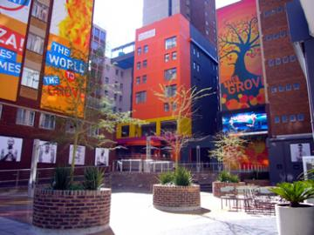
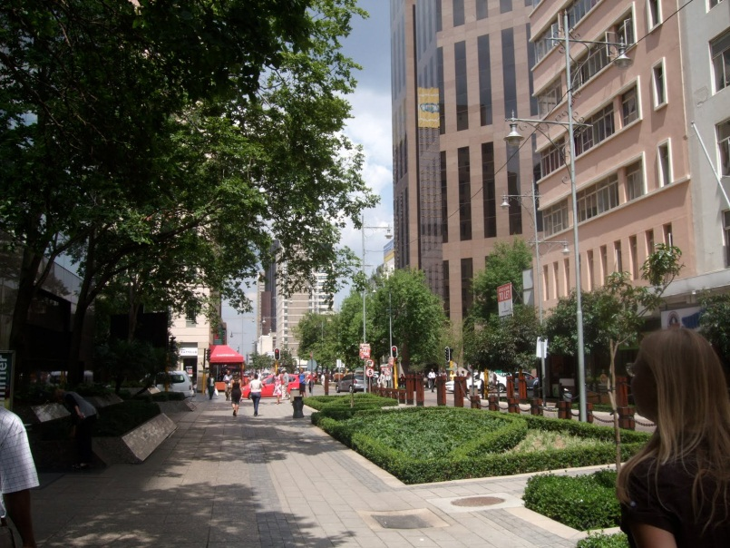
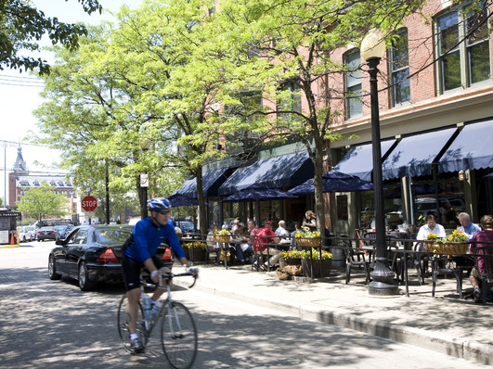
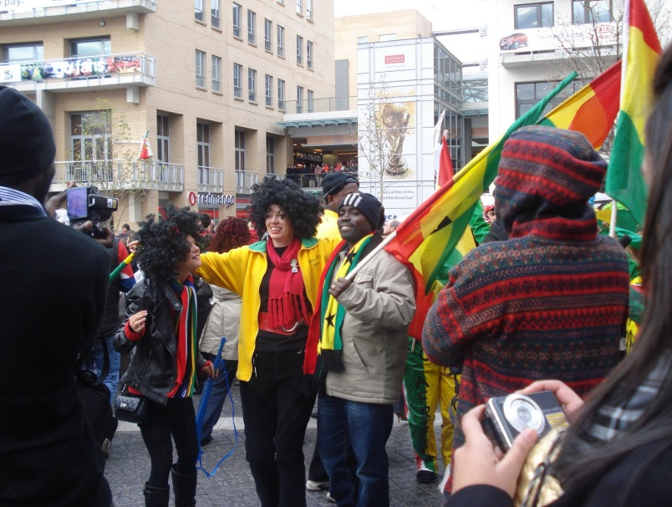
National Development Plan’s (NDP) 2030 Vision for South Africa’s Urban Areas:
VIBRANT
SUSTAINABLE
EQUITABLE
INCLUSIVE

Slide 6
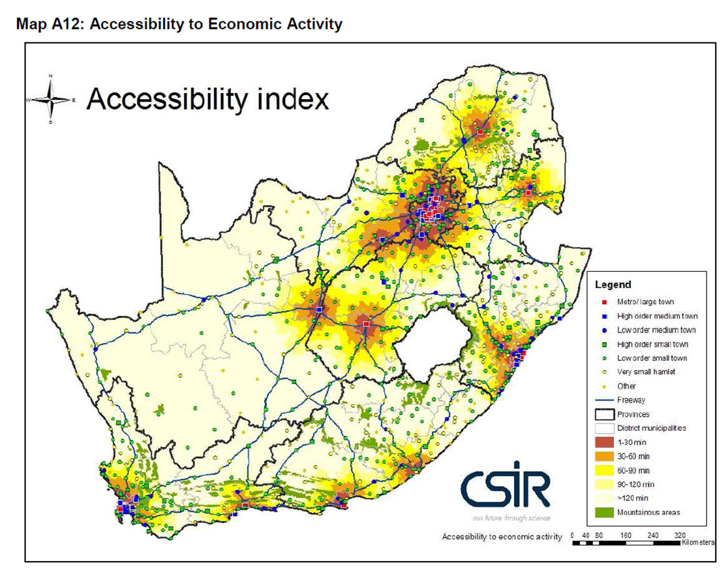
FOCUS ON CITIES AS THEY ARE THE CENTRES OF SOCIO-ECONOMIC AGGLOMERATION
Higher per capita GDP, productivity and innovation
High population concentrations, densities & lower per capita infrastructure costs
METROS
SECONDARY CITIES
Urbanising (People driven spatial targeting
Regional role

Slide 7
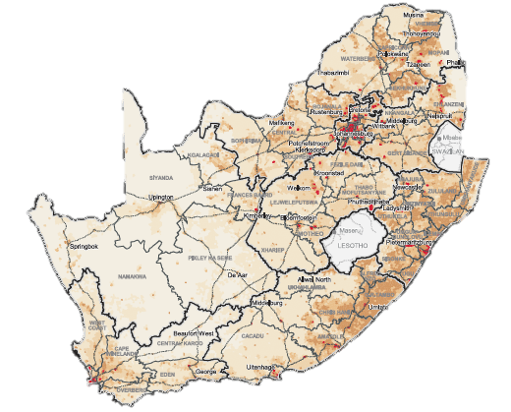
The realisation of this desired urban transformation requires significant spatial restructuring of the country’s urban areas
COMPACT CITIES
Play
Play
Public Transport
Home
Work
Home
Work

Slide 8
The Urban Networks Strategy (UNS) provides the overarching framework for this transformation
The UNS evolved in the National Treasury from, amongst other, reflections on, and work done in the Neighbourhood Development Programme (NDP)
Key amongst these was the realisation that public-led infrastructure investment, irrespective of how big and well-intended it may be, may not have the desired collective transformative impact
UNLESS
it is guided by plans that are based on the principles that have driven urban structuring and city building since the dawn of time, i.e.:
Diversity
Adaptability
Vibrancy
Connectivity
Resilience
Choice
Balance
All within a structuring, enabling & responsive framework of planned public infrastructure investment

Slide 9
The UNS seeks to put in place, through well-planned and targeted public investment, a resilient skeleton of:
Primary Nodes with ample public space
&
Connecting routes serviceable by public transport, which act as a guiding framework for private, public and communal land development

Slide 10
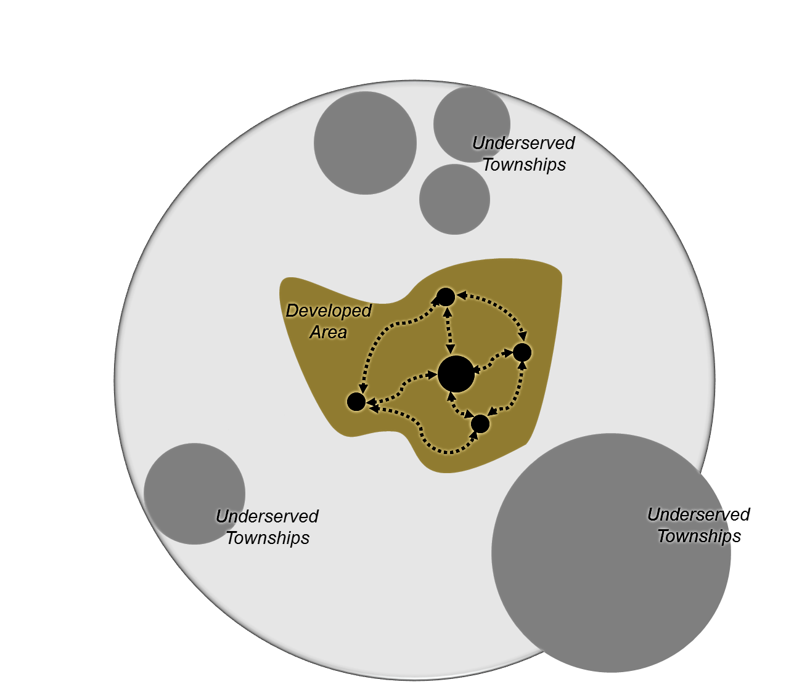
SPATIAL TARGETING: FOCUS OF THE URBAN NETWORK STRATEGY
CBD
Urban Hubs
& Secondary Transport Links
Primary Public Transport Links
Primary Corridor
CBD

Slide 11
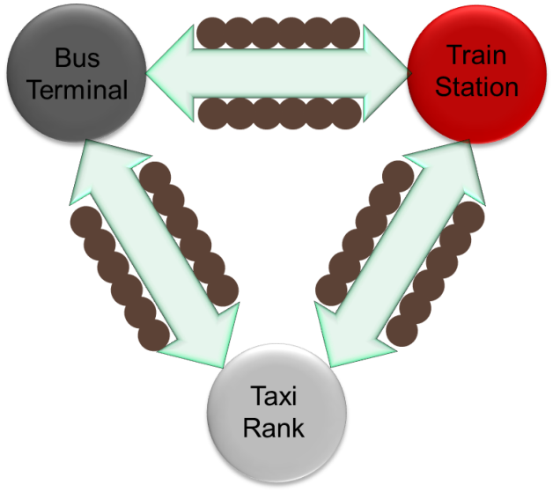
Implementing the UNS:
COMPETITIVE INFRASTRUCTURE DELIVERY PRIORITIES
CBD: Regeneration of key facilities & linkages (internal/external & across scales) for existing & new settlements
Urban Hub: Strategic cog in city-wide spatial restructuring aimed at existing marginalisation
High density, mixed use precinct
Multi-modal public transport system
Network of public spaces and walkways
Private and public sector investment
Activity Corridor: Infill/Densification for future settlements and clustered social facilities
Primary Transport Link (BRT/Rail): Rapid, affordable and safe mobility ((capital & operations)

Slide 12
THE URBAN NETWORKS STRATEGY IS AIMED AT INTEGRATED DEVELOPMENT & GROWTH
Strong urban network with a hierarchy of well connected nodes & linkages
Efficient flows of people, goods & information
Targeted public infrastructure & facilities that catalyse additional private sector investment
Good access to jobs & amenities

Slide 13
Implementing the UNS:
the following needs to be put in place…
An enabling & regulatory legal and policy framework aligned with the National Development Plan, Vision for 2030 (i.e. Chapter 8) which are integrated in to city-wide plans that promote compact, transit-oriented, sustainable communities that are good places to live.
A series of interconnected short, medium and long-term strategic spatial and sector plans that focus on spatial transformation through the co-ordination and implementation of a catalytic pipeline of projects, i.e. land development, housing, transport and infrastructure investments (and other interventions).
A coordinated public and private sector investment strategy that ensures that property development is aligned with plans

Slide 14
SECTIONS
Section 1: | Background & Context
Section 2: | The Challenge: The Human Dimension
Section 3: | Development of a Built Environment Professional
Section 4: | The Role of Institutions & Power Collective Action
Section 5: | The Sustainable Settlements Collective: Objectives into Actions
Section 6: | Taking Collective Forward Process

Slide 15
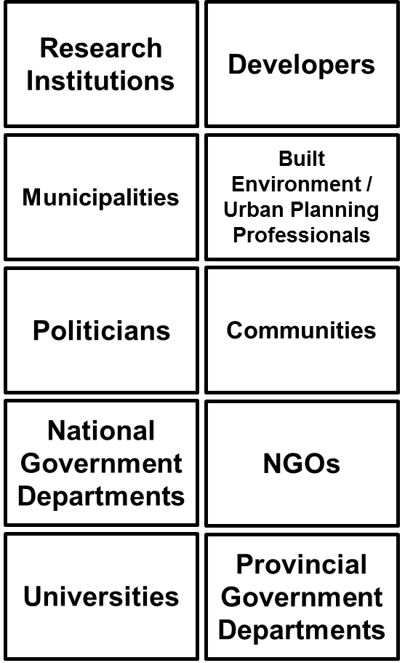
The Human Dimension
The three core requirements for the implementation of the UNS are in turn dependent on, amongst others, dedicated, competent, ethical and professional Built Environment Professionals in both the public and the private sector to:
Prepare and implement the necessary plans (Time, Cost and Quality)
Provide politicians with the necessary information to secure their buy-in and support for the plans
Advice investors and property developers to invest in accordance with the plans

Slide 16
THE CHALLENGE
Despite the key roles they can play, past experience with post-1994 urban restructuring programmes, including the Neighbourhood Development Programme, revealed that the kind of Urban Planning Professionals the UNS will require, are (1) in short supply, and (2) often do not act in accordance with their credo and/or competence
Whatever the true picture and the reason for this state of affairs, the UNS will require the right kind of built environment professionals, and hence ways will need to be found to ensure that they:
Are competent and willing to play their part,
Improve and continually improve their skills,
Act within the ethical frameworks that their professions were built on and stand for, and
Assist in the development of their fellow professionals

Slide 17
SECTIONS
Section 1: | Background & Context
Section 2: | The Challenge: The Human Dimension
Section 3: | Development of a Built Environment Professional
Section 4: | The Role of Institutions & Power Collective Action
Section 5: | The Sustainable Settlements Collective: Objectives into Actions
Section 6: | Taking Collective Forward Process

Slide 18
Being Competent
An Built Environment Professional is more than the holder of a specialised set of skills and knowledge…
Where “competency
interventions” are usually
targeted at…
Skills & experience– Technical, communication, management, research, etc.
10%
Domain specific
knowledge, expertise and specialisation
Where inspired, innovative and collaborative approaches to “competency
intervention” can have a significant impact…
Beliefs about ability of self
and profession
Passion and motivation
Willingness to take risk,
innovate
World view, values, caring
Preferences, personality,
brain profile
Sense of being valued, recognised, supported
90%

Slide 19
Becoming Competent
Typical aspects that facilitate and jump-start individual growth, action and innovation….
Opportunities to take risk
Experiencing a sense of urgency, value
A balance between stability and creative turmoil
High levels of autonomy
Tolerance for mistakes
Motivation and belief about impact
A caring, inclusive worldview
Participation in active social networks
Skills and experience
Sound knowledge base
Making an impact
Sense of achievement
Adding value through career-phases Giving back to the profession and others
Sense of purpose
Competency development as a process of life-long learning

Slide 20
SECTIONS
Section 1: | Background & Context
Section 2: | The Challenge: The Human Dimension
Section 3: | Development of a Built Environment Professional
Section 4: | The Role of Institutions & Power Collective Action
Section 5: | The Sustainable Settlements Collective: Objectives into Actions
Section 6: | Taking Collective Forward Process

Slide 21
The Role of Institutions
International and local literature and examples of improving, strengthening and deepening professional groups’ skills, values and behaviour, suggest that becoming and being a competent built environment professional is a holistic social process that:
Starts with a quality academic qualification and entails a lifetime of continuous, formal and informal learning
Flourishes in organisational environments that are supportive, enabling and innovative, yet clear as to what is ‘right’ and ‘wrong’
Requires integration between:
The various components of the profession, i.e. students, academics, practitioners and professional bodies
The organisations they work in (i.e. different spheres of, and sectors in government, and the private sector) and
The communities and society they serve
Is regulated by statutory professional bodies and nurtured and enhanced by voluntary professional bodies
Offers value to the professional over her/his lifetime, in the form of knowledge, skills, collegiality, status, the opportunity to ‘give back to the profession’, and finally, to retire with a feeling of ‘a life well lived and a community and city well served’

Slide 22
The Role of Institutions
Institution | Role/Contribution
 |  | Education & Research | Service to society programs | Internships | Mentoring | Awards | Recognition (titles) | Building the profession | Work reservation | Providing virtual information sharing spaces
 | Universities | ••••• | ••••• | •••• | ••••• | ••••• | ••••• | •••• | • | •••••
 | Municipalities | •• | •• | ••••• | •••• | ••• | •• | •• | ••••• | ••
 | National & Provincial Gov. Departments | •• | •• | ••••• | •••• | ••• | •• | •• | ••••• | ••
 | Professional Bodies | •••• | •••• | •••• | ••••• | ••••• | ••••• | ••••• | ••••• | •••••
 | Developers | • | •• | ••• | ••••• | ••• | •••• | • | • | •
 | Investment houses | • | •• | ••••• | ••• | •• | •••• | • | • | •
 | Planning / Built Environment firms | •• | ••• | ••••• | ••••• | ••••• | ••••• | ••••• | ••••• | ••
 | Associations and Networks | •••• | •••• | •••• | ••••• | ••••• | ••••• | ••• | • | •••••
 | NGOs | ••••• | ••••• | ••••• | ••••• | ••••• | ••••• | • | • | •••••

Slide 23
The Power of Collective Action
International and local literature and examples of improving, strengthening and deepening professional groups’ skills, values and behaviour, suggest that becoming and being a competent urban planning professional can be enhanced by:
Strengthening university departments offering professional degrees by providing more/better facilities, staff and/or funds for research
Instituting ‘service to society’ through structured university/student-community engagements/service periods
Setting up focussed mentoring and internship programmes
Putting in place desirable awards for different categories of excellence in the profession
Endowing exemplary professionals with titles that recognise, proclaim and celebrate their achievements
Strengthening professional bodies, and assisting them to enhance the profile of the profession amongst other professional groupings and society at large
Limiting certain types or categories of work to professionals that (1) have achieved certain levels of competence, and (2) maintain and expand their skills set through continued professional development
Providing real and virtual spaces for posting and sharing information, and establishing services

Slide 24
SECTIONS
Section 1: | Background & Context
Section 2: | The Challenge: The Human Dimension
Section 3: | Development of a Built Environment Professional
Section 4: | The Role of Institutions & Power Collective Action
Section 5: | The Sustainable Settlements Collective: Objectives into Actions
Section 6: | Taking Collective Forward Process

Slide 25
“SUSTAINABLE SETTLEMENTS COLLECTIVE” PROJECT OBJECTIVES
To mainstream the Governments Urban Spatial Transformation Agenda (see next slide) and how to expose it within curriculum and wider research agenda of the tertiary institutions
To target and the Built Environment (BE) profession through institutions, i.e. both at the tertiary academic and the professional council / statutory level
To bring an appreciation and recognition of both:
Service back to society (being more developmental); and
Quality, experience and passion for the profession
To use a functional continuous professional development (CPD) system as a method to differentiate on these criteria
To have the ability to track individuals process / contribution as well as to identify as specialists for government panels, assignment & projects.
To compliment existing capacity building / support programmes
E.g. The Infrastructure Skills Development Grant (ISDG).
Notes:
Undiversified and marginal local economies in townships

Slide 26
Governments Urban Spatial Agenda
Governments Urban Spatial Agenda
The outcome of the Urban Network Strategy (NDPG)
Integrated urban development framework (IUDF)
Integrated Human Settlements (Transport, Housing and Infrastructure Investments)
Chapter 8 of the NDP on Human Settlements
Infrastructure Skills Development Grant (ISDG).
Outcome 8 of Government’s Performance Outcomes
Presidential Infrastructure Coordinating Committee (PICC) & 18 strategic integrated projects (SIPS)

Slide 27
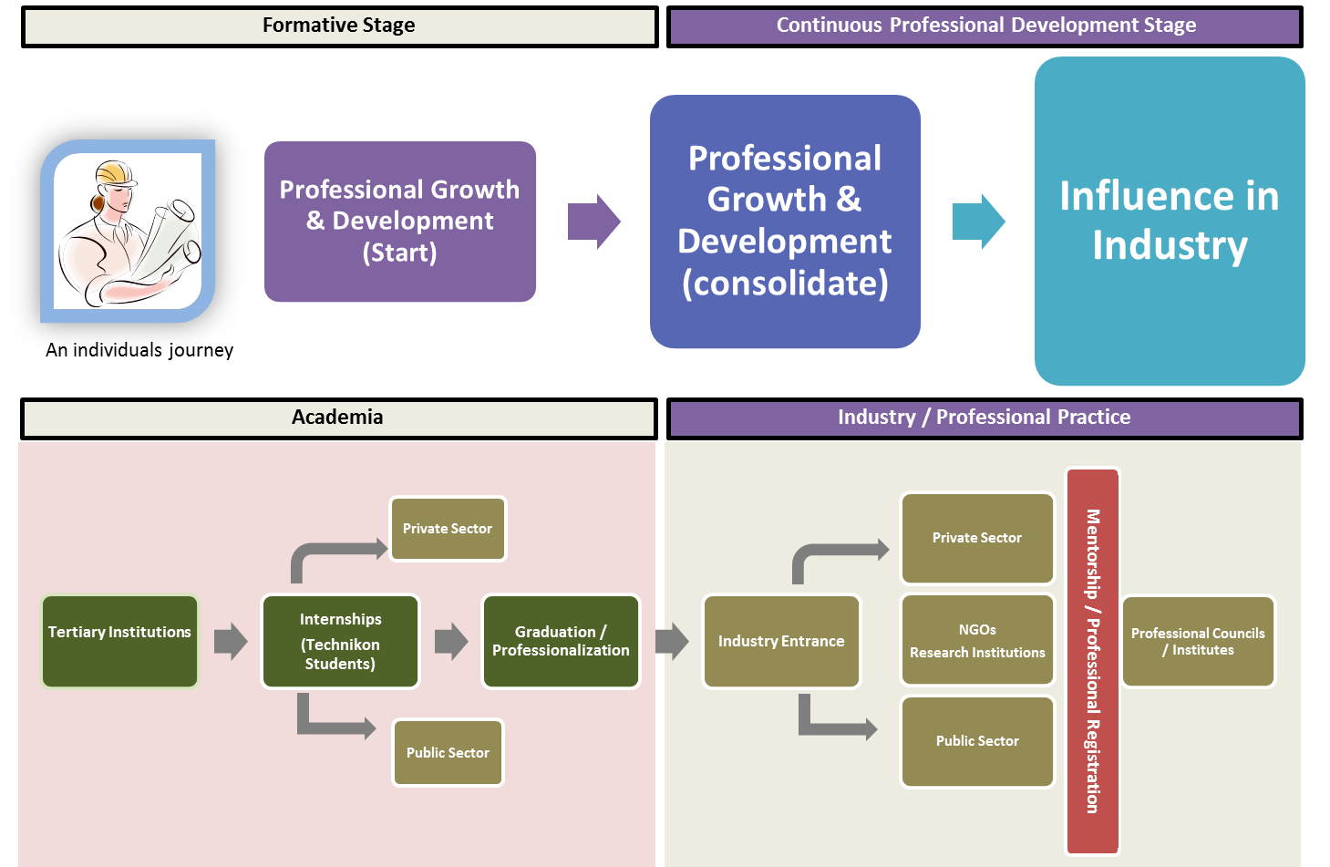
JOURNEY OF A BUILD ENVIRONMENT PROFESSIONAL
Notes:
Undiversified and marginal local economies in townships

Slide 28
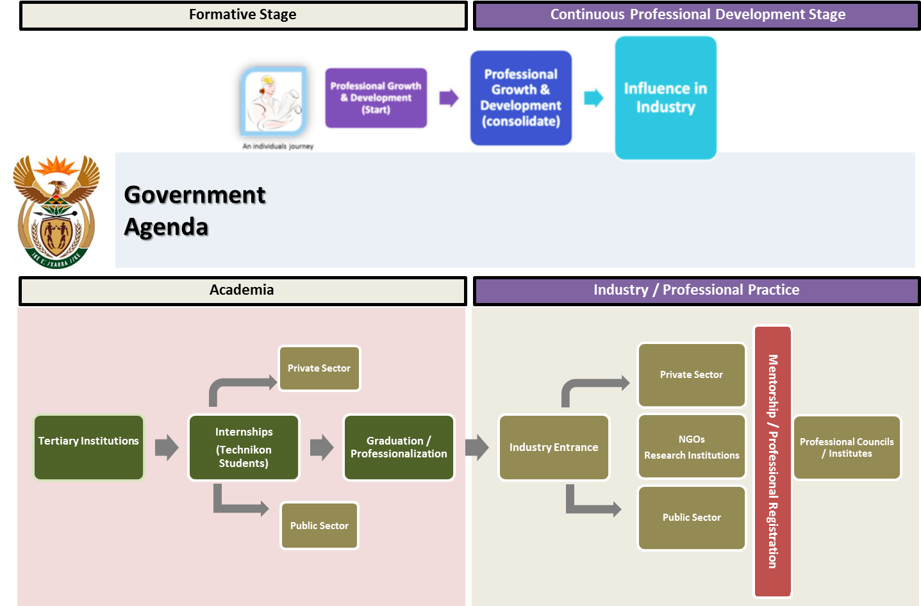
JOURNEY OF A BUILD ENVIRONMENT PROFESSIONAL
GAP#1
Monitoring Supply & Demand
GAP#3
Recognising: Experience, Excellence & Effort
GAP#2
Linking theory & practice to outcomes
GAP#4
Continuous Improvement
MENTOR/INTERN
MENTOR/INTERN
MENTOR/INTERN
MENTOR/INTERN
Infrastructure Skills Development Grant (Current)
Notes:
Undiversified and marginal local economies in townships

Slide 29
JOURNEY OF A BUILD ENVIRONMENT PROFESSIONAL
GAP#1
Monitoring Supply & Demand
GAP#3
Recognising: Experience, Excellence & Effort
Taught Curriculum
Mentorship & Accreditation
1
2
3. ALIGNMENT & IMPROVEMENT
GAP#2
Linking theory & practice to outcomes
GAP#4
Continuous Improvement
MENTOR/INTERN
MENTOR/INTERN
MENTOR/INTERN
MENTOR/INTERN
Infrastructure Skills Development Grant (Current)
Notes:
Undiversified and marginal local economies in townships

Slide 30
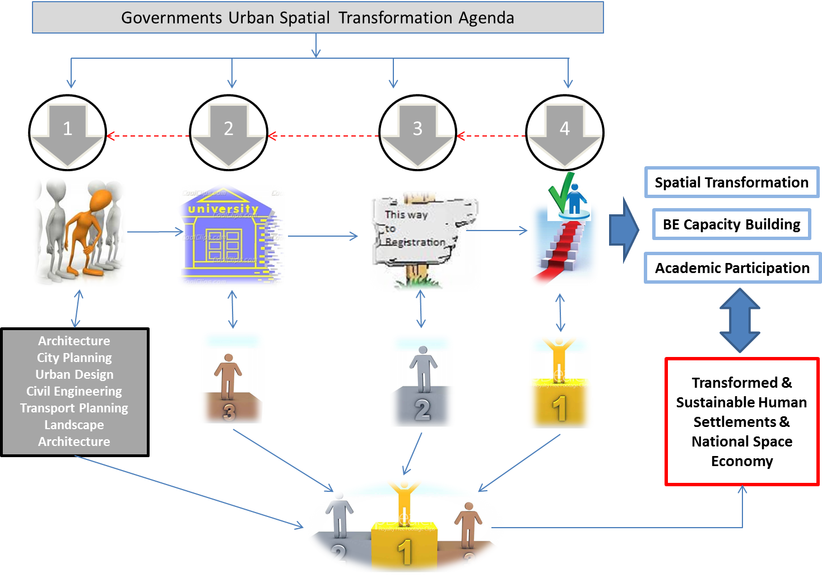
TRANSLATING THE IDEA INTO ACTION

Slide 31
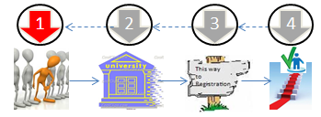
GAP#1
Monitoring Supply & Demand
TRANSLATING THE IDEA
INTO ACTION – PART I
Student ID & Progress Monitoring “System”
Architecture
City Planning
Urban Design
Civil Engineering
Transport Planning
Landscape Architecture
1
A BE student enters their first year and registered (on a system) with the council and / or professional body prior to their professional study in preparation for their professional development plan (PDP) and a 3 tier Professional Accreditation
Each professional study area may have its own PDP to meet its academic requirements, but also be aligned to achieving the objectives of the this initiative under the umbrella objectives of the Government Agenda
The system will monitor the academic and professional progress of each individual based on the requirements of each individual step of the PDP.
Progress Monitoring System “database” for BE individuals
starting @ Tertiary Education through to professional Councils and Institutes

Slide 32
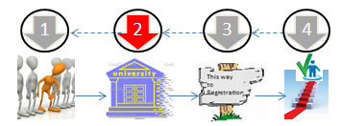
GAP#2
Linking theory & practice to outcomes
TRANSLATING THE IDEA
INTO ACTION – PART II
Architecture
City Planning
Urban Design
Civil Engineering
Transport Planning
Landscape Architecture
2
Academic Knowhow / Training
To influence the academic output (content and individuals) of the BE academic programmes
Long Term: Curriculum to include and align to the government’s (and businesses) national plans
To address risk of “interfering” with academic independence
Short to Medium Term :
Produce an “Introduction to the Government Agenda” module / day / discussion
Host a national ‘real’ case study university competition:
ID a real case study project with typical symptoms of the challenges facing SAn towns and cities. Multi/Inter-disciplinary BE student teams to propose planning and management solutions as part of their PDP. As an incentive students to earn points / recognition as part of their professional registration process and universities recognition for their contribution in solving societal problems. Link to NDP projects / case studies per province
Postgraduate Research Outputs:
Agreement with institutions to commission a certain type of ‘real’ case research that is aligned to the UNS through a ‘UNS Research Fund’.
Package Government Agenda for Academic Curriculum
Introduce and align (over time) Government Agenda & Academic Curriculum
Common Research Agenda

Slide 33
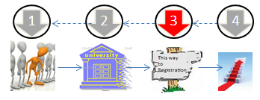
GAP#3
Differentiation: Experience, Excellence & Effort
TRANSLATING THE IDEA
INTO ACTION – PART III
Architecture
City Planning
Urban Design
Civil Engineering
Transport Planning
Landscape Architecture
3
Professional Councils
Professional Councils and Institutes to be an integral part of the individual PDPs by coordinating / hosting some students but mostly professionals’ related development functions.
A 3 Tier System to be considered:
Student Registration: As per current system.
Professional Registration:
Quarterly submitted log book signed by a pre-approved Senior Professionals (who are @ Tier 3 themselves (mentoring)
Board exam that covers various aspects of the professions equivalent to this level
Senior / Expert Professional Registration:
Eligibility: Minimum of 15 Years post professional registration experience.
Board exam that covers various aspects of the professions equivalent to this level
Competency / Registration assessments to include alignment / competency on Government Agenda
Role / responsibility (capacity?) of Professional Councils and Institutes to upgrade & lead PDP
Design & buy-in differentiated 3 Tier PDP Systems

Slide 34
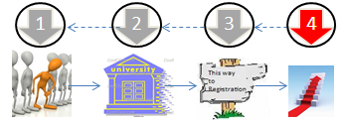
GAP#4
Continuous Improvement
TRANSLATING THE IDEA
INTO ACTION – PART IV
Architecture
City Planning
Urban Design
Civil Engineering
Transport Planning
Landscape Architecture
4.
On-going Senior / Expert Professionalization
Competency / registration assessments and eligibility criteria needs to be discussed.
Assessment Level and Content
On-going / continuous development
Service to society credits (mentoring / internships)
Registration needs to be renewed by means of an assessment every ???? years.
Experts to be considered as part of the NDP/UNS expert database.
Creating a legitimate governance competency / registration process
Process to acknowledge “service to society” & development agenda
Qualifying for government contracts

Slide 35
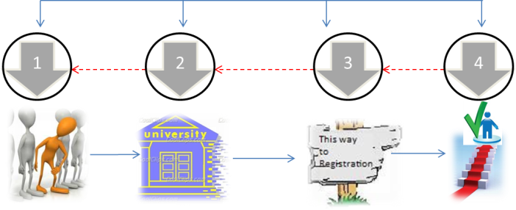
TRANSLATING THE IDEA INTO ACTION – CONSOLIDTED
Architecture
City Planning
Urban Design
Civil Engineering
Transport Planning
Landscape Architecture
Creating a legitimate governance competency / registration process
Process to acknowledge “service to society” & development agenda
Qualifying for government contracts
Role / responsibility (capacity?) of Professional Councils and Institutes to upgrade & lead PDP
Design & buy-in differentiated 3 Tier PDP Systems
Package Government Agenda for Academic Curriculum
Introduce and align (over time) Government Agenda & Academic Curriculum
Common Research Agenda
Progress Monitoring System “database” for BE individuals
starting @ Tertiary Level through to professional Councils and Institutes

Slide 36
SECTIONS
Section 1: | Background & Context
Section 2: | The Challenge: The Human Dimension
Section 3: | Development of a Built Environment Professional
Section 4: | The Role of Institutions & Power Collective Action
Section 5: | The Sustainable Settlements Collective: Objectives into Actions
Section 6: | Taking Collective Forward Process

Slide 37
Process / Next Steps
STATUS QUO
START
GOAL

Slide 38
Process / Next Steps
Council for the Built Environment
South African Planning Institute
South African Council for Planners
Planning Schools
Wits University
University of Pretoria
Gauteng Institute of Architects
CSIR
South African
National Planning Commission
The Association of SA Quantity Surveyors
South African Construction Project Management and Construction Management Professions
The South African Institution of Civil Engineering (TBC)

